Slide 1

Student Performance Predicting - A Data-Driven Approach
PRASANNAJEET - 202410116100145
NIKITA AGARWAL-202410116100133
NITIN NEGI-202410116100137
POORNIMA-202410116100142
SUBMITTED TO - Ms. KOMAL SALGOTRA

Slide 2

Introduction: Why Predict Student Performance?
Predicting student performance enables early intervention, allowing educators to identify struggling students proactively. This benefits students by providing timely support, educators by facilitating targeted instruction, and institutions by improving overall educational outcomes and resource allocation.
Personalized learning can be improved by tailoring teaching methods to individual student needs, resources optimized by directing support to where it is most needed, and student success rates enhanced through data-driven strategies that promote academic achievement.
Early identification of at-risk students
Customization of learning approaches
Efficient allocation of educational resources

Slide 3

Data Sources and Features
Data Source: KAGGLE
Features: Gender, race/ethnicity, parental education, lunch, test preparation course, math score, reading score, writing score
Target Variable: Average exam score

Slide 4

Methodology: Machine Learning Models
Chose Random Forest Regressor for its robustness and interpretability. Its ensemble nature helps reduce overfitting, providing more reliable predictions.
Split data into training (80%) and testing (20%) sets to evaluate the model's performance on unseen data, ensuring generalization.
Trained the model using 100 estimators (trees). Each tree contributes to the final prediction, and the number was chosen based on performance tuning.

Slide 5
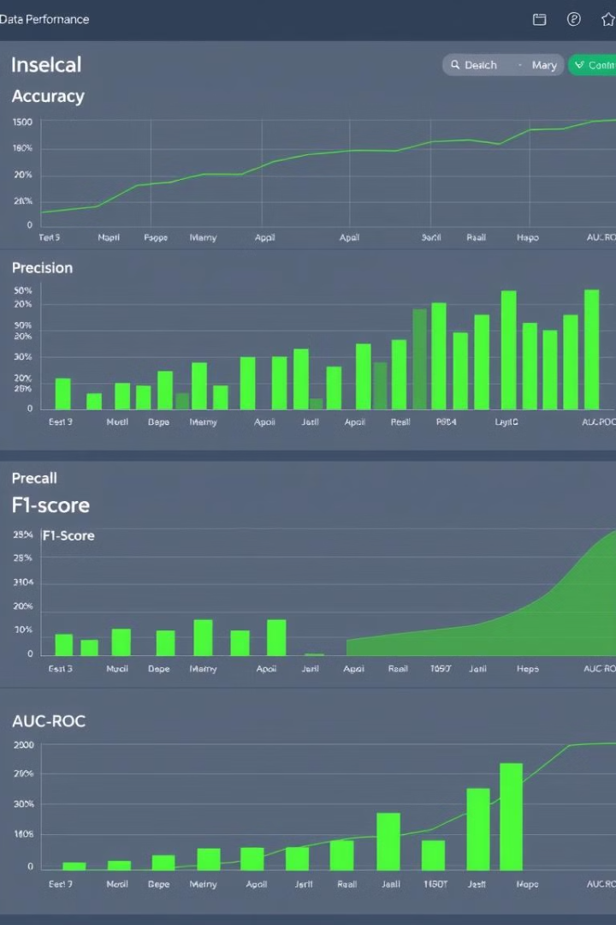
Evaluation Metrics: Measuring Predictive Accuracy
Mean Absolute Error (MAE): 10.39MAE represents the average magnitude of errors in a set of predictions, without considering their direction. It is calculated as the average of the absolute differences between predicted and actual values. A lower MAE indicates better model accuracy.
Mean Squared Error (MSE): 157.37MSE measures the average of the squares of the errors. Squaring the errors gives higher weight to larger errors, making MSE more sensitive to outliers than MAE. Like MAE, a lower MSE indicates better model accuracy.
R² Score: 0.0875 (Indicates limited predictive power, potential for improvement)The R² score, also known as the coefficient of determination, represents the proportion of the variance in the dependent variable that is predictable from the independent variables. An R² score of 0.0875 suggests that the model explains only a small fraction of the variability in the target variable, indicating a poor fit and the need for model improvement.

Slide 6

Results and Findings: What Did We Learn?

Slide 7
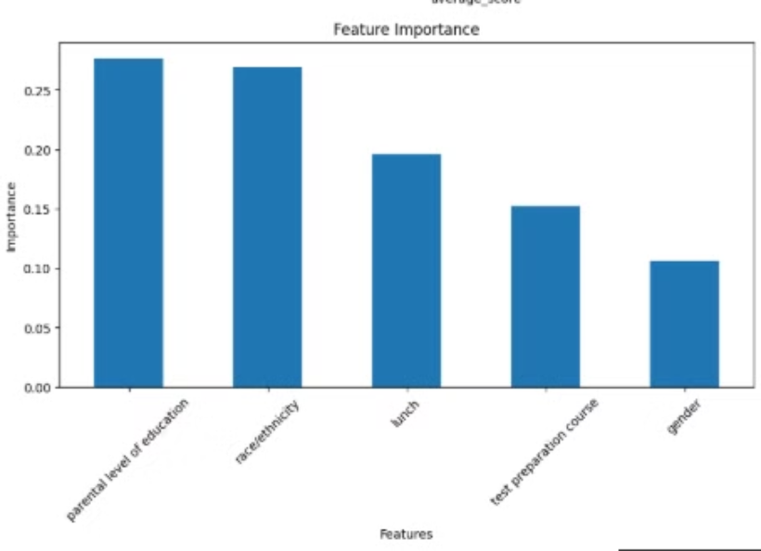
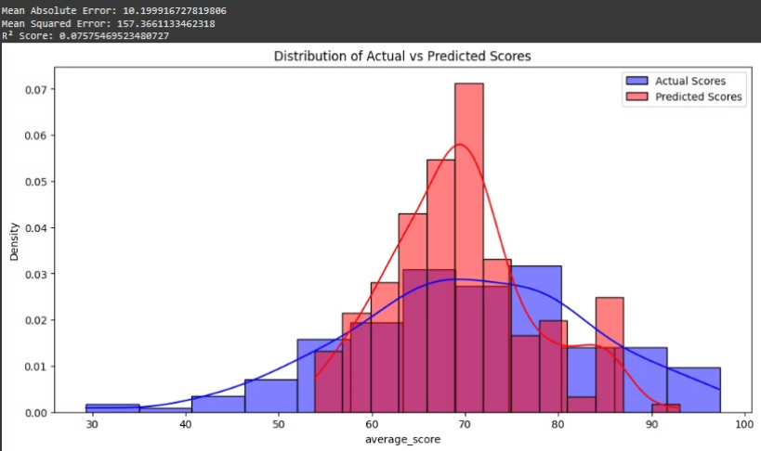

Slide 8

Real-World Applications
Helping educators identify students at risk: By identifying students at risk early, educators can provide timely interventions such as tutoring, counseling, or modified assignments. This proactive approach can significantly improve student outcomes and prevent academic failure.
Personalizing learning strategies: Predictive models can help tailor learning experiences to individual student needs. This includes adjusting the pace of instruction, providing targeted support, and offering enrichment activities based on predicted performance.
Policy-making for educational institutions: Institutions can use insights from student performance prediction to inform policy decisions. This may involve allocating resources to specific programs, adjusting curriculum, or implementing new support systems to improve overall student success rates.
These real-world applications highlight the potential of student performance prediction to transform education by enabling data-driven decisions and interventions. While there are challenges to address, the benefits of improved student outcomes and optimized resource allocation make it a worthwhile endeavor.

Slide 9

Conclusion
In summary, data-driven approaches improve student success. We encourage wider adoption of such methods.

Slide 10
THANK YOU!

